Slide 1
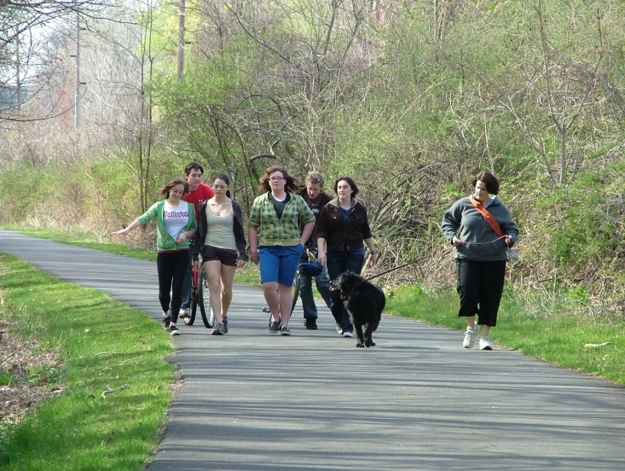
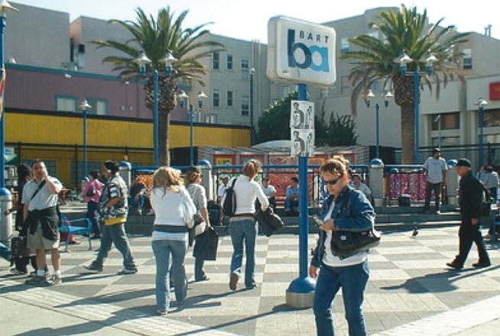
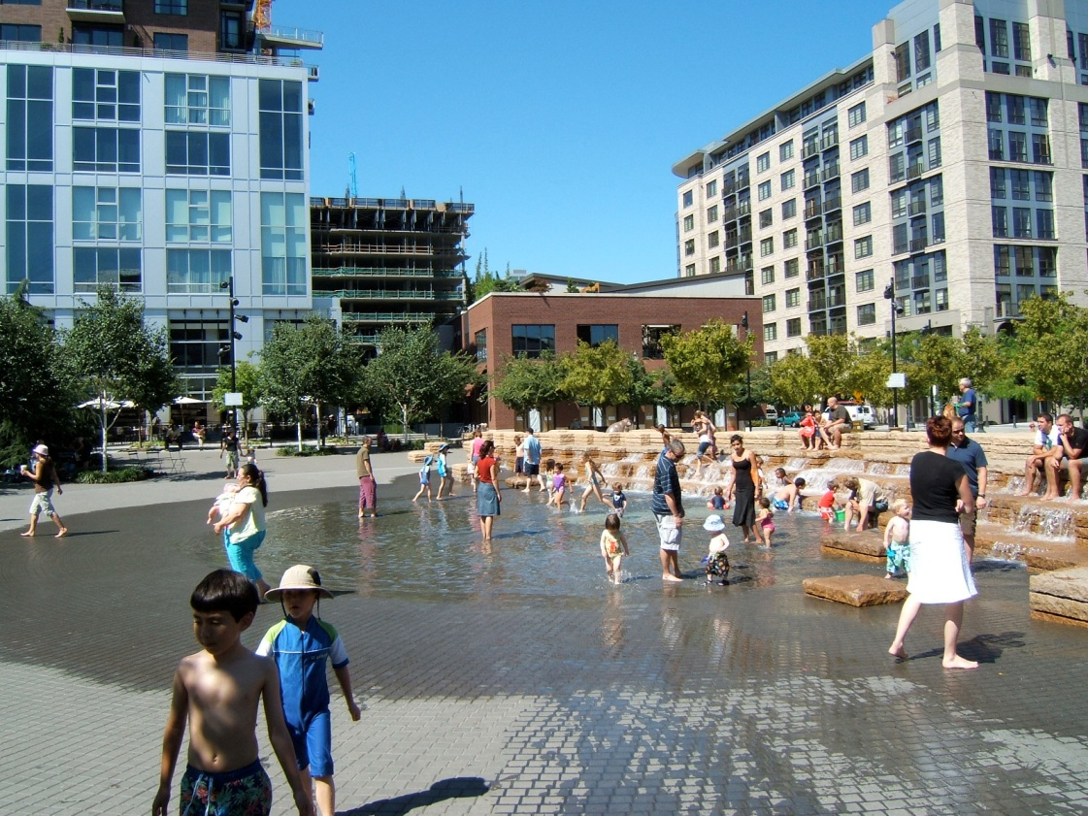
Policies explaining the emergence of the bicycle commuter in
Bogotá

Slide 2
Three General Strategies in the City of Bogota
Car use reduction
Transit prioritization
Bicycle
- Infrastructure improvements and campaigns to improve bicycle culture

Slide 3
Since the late 2000s, the city has experienced a solid and sustained rise in the number of urban cyclists
The bicycle mode share has increased from 0.58% of all means of transportation in 1996 (Japan International Cooperation Agency, 1996) to 4.50% of the commute mode share, or 10.70% excluding walking trips, reported in the last Transportation Authority Household Survey (TAHS) in 2015.
In the same year, an average of 575,356 trips per day were made by bicycle (about 74% by men)
A more recent survey applied in 2017, from a socioeconomic- based representative sample of 1056 individuals, revealed an estimated value of 9.10% in bicycle share (Bogotá Cómo Vamos, 2017).

Slide 4
Bicycle commute mode share growth in Bogotá

Slide 5
Bike ridership comparison of cities in the Latin American region

Slide 6
Before 1995: a latent bicycle culture, oil crisis, and Ciclovía
The bicycle has been part of Colombian culture almost since its invention in 1817 (Pardo, 2013).
First, users biked for recreation, sport, and, to a lesser extent, transportation.
Since 1950, and for 40 years, professional racing became part of Colombian culture due to the good performance of national racers.
In the 1970s, while automobile ownership and use grew rapidly, a group of young concerned citizens pushed for the bike movement in the city.
In Bogotá, the car was a symbol of high social status and wealth, while cycling, walking, and riding transit was associated with low income
The period change the social stigma that the bicycle was only for poor people
During the 1980s and 1990s, city planning in Bogotá was mostly car-oriented and the social status of cars was far higher than other modes of transportation

Slide 7
1995–2004: the kick off of the bicycle as a means of transportation
During the 1995–2004 period, there was a change in the city's transportation planning.
The change from a “car-centered transportation system to a people-oriented one.” (all street users are equal)
This lead to street space reallocation processes, where parking was abolished to create sidewalks and bicycle paths, and many exclusive bus lanes were provided (specifically BRT segregated lanes and priority non-segregated lanes for conventional buses).
these changes derived from at least four components: a clear policy, political leadership, available resources, and direct and effective actions
In 1998–2000, Enrique Peñalosa executed his plan entitled Por la Bogotá que queremos (“For the Bogotá we want”)

Slide 8
1995–2004: the kick off of the bicycle as a means of transportation
Peñalosa invested almost three times as many resources and set much more aggressive goals.
Strengthening institutions, restricting car use, investing in public space and public transportation, roads maintenance, and traffic management
Some effective actions for restraining car use implemented by Peñalosa in 1998 were the Día sin Carro (Car-free Day) and the Pico y Placa programs.
The Car-free Day restricts car use on a working day and opens a space, once a year, for alternative modes to the car such as the bicycle.
The Pico y Placa program, on the other hand, restricts car circulation on two or three days a week, depending on the last number of the license plate.
In addition, the municipal surtax on gasoline was increased from 15 to 20%

Slide 9
Regarding public transportation, the mass bus rapid transit TransMilenio was implemented in 2000, using exclusive lanes and stations for its operation. The system included parking spaces (4417 by 2017) for bicycles in 17 of its stations inviting citizens to ride their bicycles for short distances (last mile) and use mass transit for long distances, promoting intermodality.
The planning of future TransMilenio lines predetermined the construction of new bike linear infrastructure along the same corridors

Slide 10
45 more kilometers of bike infrastructure were built and a program named “Intelligent Mobility” was implemented to reduce accidents involving pedestrians and cyclists.

Slide 11
2004–2012: bicycle relegation and bicycle culture blooming
Between 2004 and 2012, the city governments' priorities changed, leading to a sharp decline (sometimes complete absence) of the previous bicycle actions and policies.
None of the elected mayors during this period carried out any effective or innovative pro-bike action.
The few kilometers of off-street bike-paths they built in their periods were already included in previous City Plans and they did not design them with a proper planning to improve network connectivity.
The construction of new Transmilenio trunk lines reduced the Ciclovía network (bicycle network) due to its proximity to the articulated buses.
There was evident damage and deterioration due to lack of maintenance

Slide 12
2012–2019: bicycle bounces back
After eight years of absence of political will and actions promoting the bicycle, important programs were reintroduced to the mayor's plans and policies.
The City Plan of Gustavo Petro’s government (2012–2015) entitled Bogotá Humana (Humane Bogotá), included investment in the construction of 145 km of bicycle paths, of which he actually built 63.1

Slide 15
Bicycle ownership and trip generation for private and public transportation, and bicycle modes for years 1995, 2005, and 2011

